Slide 1
CS 613 Project Presentation
Inductive Graphs and Functional Graph Algorithms
Himanshu Singh (16305R005), Vikas Kumar(163059007)
23 Nov 2017

Slide 2
Content
Motivation
Goal of Project
Inductive Graphs
Some useful functions
Functional Graph Algorithms (BFS, DFS)
“Splitwise” Implementation

Slide 3
Motivation
“When a node is reached by more than one node and algorithm requires it to be visited at most one time.”
In haskell , it can be can be achieved by passing a list to a function which maintains the state for each node if it is visited or not.
Issues:
Efficiency : BBST to store state of each node O(logn)
Clarity : Data Structure has to be passed as argument to each function

Slide 4
Goal of Project
To understand Data.Graph.Inductive Library and use graph algorithms to implement “Splitwise’s Simplify Feature” to reduce number of transactions required to settle up expenses.

Slide 5
Inductive Graph
This paper focuses on representing a graph as an inductive data structure.
Graph is represented by two constructors
Context and
Empty
type Node = Int
type Adj b = [(b, Node)]
type Context a b = (Adj b, Node, a, Adj b)
graph is defined using Context and another constructor Empty
data Graph a b = Empty | Context a b & Graph a b

Slide 6
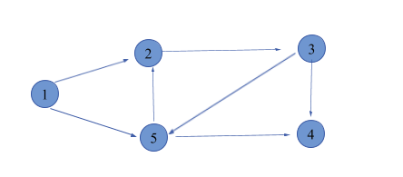
Edge from vertex u to v be named as “u->v” and Label for vertex i be vi.
We can build the graph with this expression
( [ ], 1, ‘v1’, [(“v1->v2”, 2), (“v1->v5”, 5)]) &
([(“v5->v2”, 5)], 2, ‘v2’, [(“v2->v3”, 3)]) &
([ ], 3,’v3’, [(“v3->v4”,4),(“v3->v5”,5)] &
([(“v5->v4”,5)], 4,’v4’, [ ]) &
([ ], 5,’v5’, [ ]) & Empty

Slide 7
Similarly we can also reverse the order of inserting node contexts
([(“v1->v5”,1),(“v3->v5”,3)], 5,’v5’, [(“v5->v2”,2),(“v5->v4”,4)]) &
([(“v3->v4”,3)], 4,’v4’, [ ]) &
([(“v2->v3”,2)], 3,’v3’, [ ]) &
([(“v1->v2”, 1)], 2, ‘v2’, [ ]) &
( [ ], 1, ‘v1’, [ ]) & Empty

Slide 8
Some useful operations
newNodes : This function is useful for extending the graph which construction history is not known.
newNodes :: Int -> Graph a b -> [Node]
newNodes i g = [n+1..n+i] where n = foldr max 0 (nodes g)
nodes : This function extracts the node values from a graph.
nodes :: Graph a b -> [Node]
nodes = ufold (\(p,v,l,s)->(v:)) []
ufold :: (Context a b -> c -> c)->c->(Graph a b)->c
ufold f u Empty = u
ufold f u (c&g) = f c (ufold f u g)

Slide 9
Some useful operations
gmap using ufold
gmap f = ufold (\c->(f c &)) Empty
isEmpty: checks if a graph is empty or not.
isEmpty :: Graph a b -> Bool
isEmpty Empty = True
isEmpty _ = False

Slide 10
Some useful operations
map function for graph :
gmap :: (Context a b -> Context c d) -> Graph a b -> Graph c d
gmap f Empty = Empty
gmap f (c & g) = f c & gmap f g
gmap preserves the structure of the node but not necessarily structure of edges.
reverse function for graph:
grev :: Graph a b -> Graph a b
grev = gmap swap
where swap (p, v, l, s) = (s, v, l, p)
predecessor and successor are swapped for each node.

Slide 11
DFS & BFS Algorithms using Inductive Graphs
Depth First Search:
dfs :: [Node] -> Graph a b -> [Node]
dfs [] g = []
dfs (v:vs) (c &^{v} g) = v:dfs (succ c ++ vs) g
dfs (v:vs) g = dfs vs g
Breadth First Search:
bfs :: [Node] -> Graph a b -> [Node]
bfs [] g = []
bfs (v:vs) (c &^{v} g) = v:bfs (vs ++ suc c) g
bfs (v:vs) g = bfs vs g

Slide 12
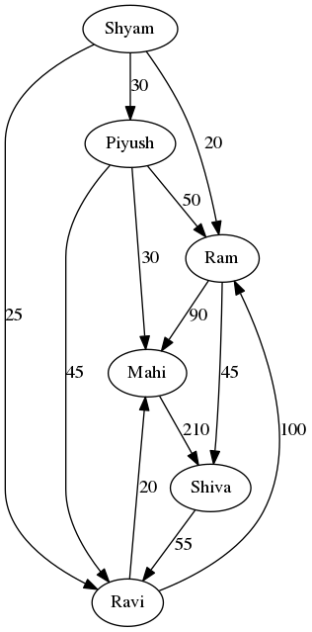
Simplify Feature
Let Six friends (Shyam, Piyush, Ram, Mahi, Shiva, Ravi) went for a trip. If A has to pay x rupees to B then it is represented as an edge from A to B with x as it’s label. So, right side figure represents amount of money one has to give to other. There are certainly some redundant transactions e.g. Shyam has to pay Piyush 30 rupees and Piyush has to pay Mahi 30 rupees. Why not Shyam just pays Mahi 30 rupees. Hence, instead of two transactions only one transaction required. What’s the solution?

Slide 13
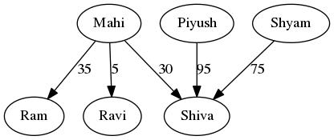
Simplify Feature
It turns out that only these many transactions are required. Initially there were 12 transactions but here only 5 transactions are required. This is good relief from headache.

Slide 14
The Algorithm
Step 1 : Find out net amount of money one has to pay i.e. it is positive for a user if he has to pay to someone and negative if he is getting from someone.
Step 2 : Make two lists : 1.) Giver : consists of person who has to pay someone when net balance is calculated 2.) Taker : consists of person who has to take money from someone when net balance is calculated.
Step 3 : Sort both lists.
Step 4 : Make a bipartite graph where one set of users belong to Giver and other set belongs to Taker.
Step 5 : First make an edge between two users if they exactly satisfy the demand and supply. Take first user from Giver and Taker, if Giver has to give more than the Taker has to take then make an edge from Giver to Taker with label as the amount that Taker has to take. Increment the pointer in Taker list. Keep pointer in Giver list at the same position while updating the new amount for Giver as (Giver – Taker).

Slide 15
The Algorithm
Step 5 (Continued) : Similarly, if Giver has to give less than the Taker has to take then make an edge from Giver to Taker with label as the amount that Giver has to give. Increment the pointer in Giver’s list while keeping the pointer in taker list at the same position updating it’s new amount to (Taker-Giver). If amount that Giver has to give and Taker has to take are exactly same then make an edge from Giver to Taker with edge label as the amount and increment the pointer in both lists.
Step 6 : Continue like Step 5 till both lists are empty.
This algorithm guarantees that there will be atmost (|V|-1) number of transactions because the graph is acyclic.

Slide 16
Thank You (> <)

